Slide 1

Capstone Project:
Game Pricing Optimization Using Deep Learning
Wenshan, Liu

Slide 2

Intro: Smart Pricing Strategies for Video Games
• The video game market is highly competitive and diverse.
• Pricing affects sales performance but is hard to optimize due to limited data.
• This project introduces a cluster-based pricing model using NLP and deep learning to enhance predictions and revenue potential.

Slide 3

Problem Identification
• Only one historical price per game → no alternative pricing insights.
• Player sentiment is often ignored in sales predictions.
• No universal price strategy — different genres and platforms require custom models.
• Our solution: sentiment-based modeling + simulation.

Slide 4

Data Sources
• VGChartz: Global and regional sales data
• Metacritic: User and critic reviews (used for NLP)
• Dekudeals: Nintendo Switch price data

Slide 5
Methodology: Data Normalization and Merging
• Normalize multi-platform entries into single-platform rows.
• Focus on Nintendo Switch for consistency.
• Use TF-IDF vectorization + cosine similarity for fuzzy join (threshold = 0.7).
• Final dataset includes price, reviews, sales, sentiment, etc.

Slide 6

Preprocessing for modeling
• Remove duplicates/nulls.
• Convert release date to year/month/quarter.
• Clean and convert price fields to numeric.
• These steps support both statistical and NLP models.

Slide 7

Sentiment Feature Extraction with NLP
• Text Cleaning: Tokenization, stopword removal, stemming, lemmatization.
• NER + TF-IDF: For structured feature extraction.
• Sentiment Labeling: VADER assigns labels → used as pseudo-labels.
• Model Training: Random Forest mimics/enhances VADER.
• Output: predicted_sentiment used for modeling.

Slide 8
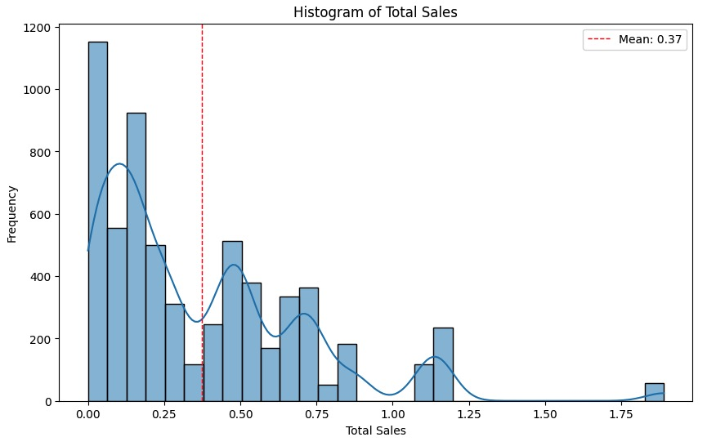
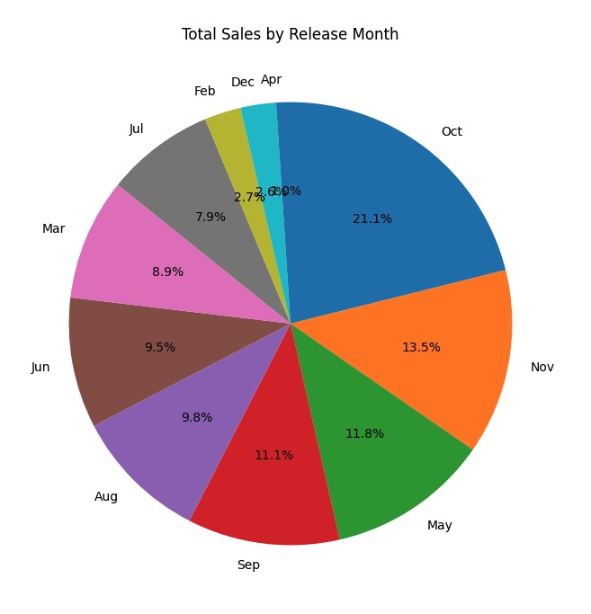
EDA Findings
Total Sales: Right-skewed.
Sales By Months: October have the highest sales.

Slide 9
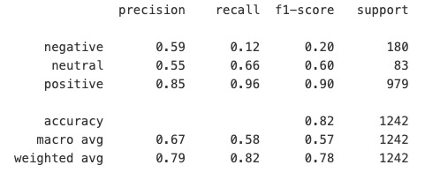
Sentiment Classifier Performance
• Model: Random Forest
• Accuracy: 82%
• High F1 for positive, weak for negative (recall = 0.12).
Future work: Use class balancing (e.g., oversampling).

Slide 10
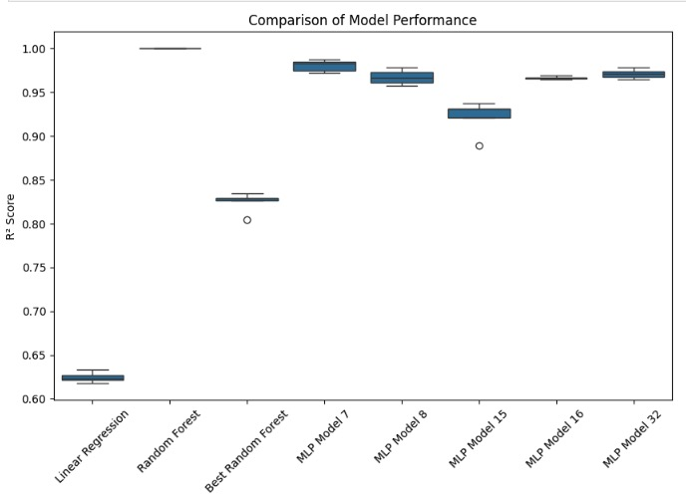
Regression Model Comparison
Baseline (Linear Regression): R² = 0.635
Basic Randon Forest (untuned): R² = 0.999
Random Forest (Tuned): R² = 0.852
Best MLP (Model16): R² = 0.9739.

Slide 11
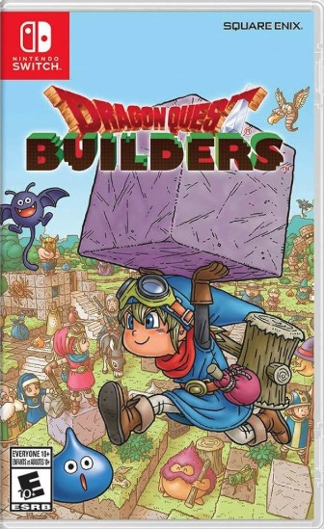
Case Study
Game: Dragon Quest Builders 3(not release yet) as test case.
Tested for Feb & Nov 2025 release scenarios.
Data-driven pricing can optimize revenue effectively.

Slide 12
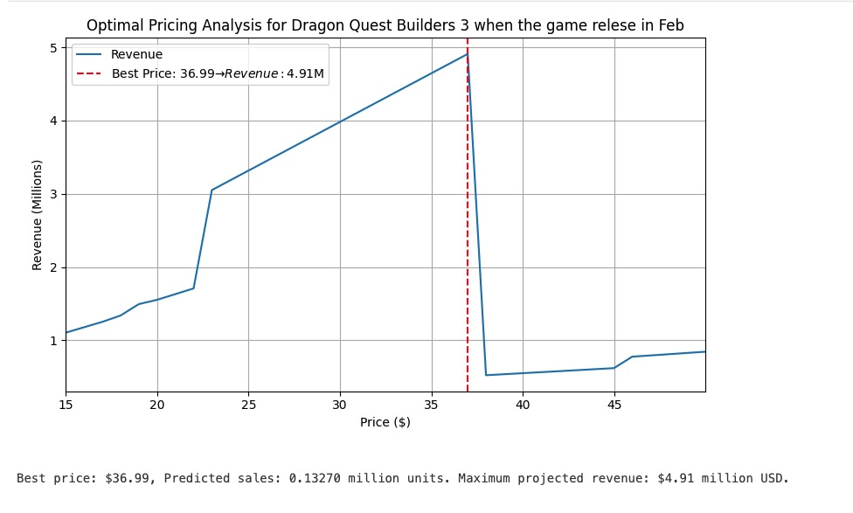
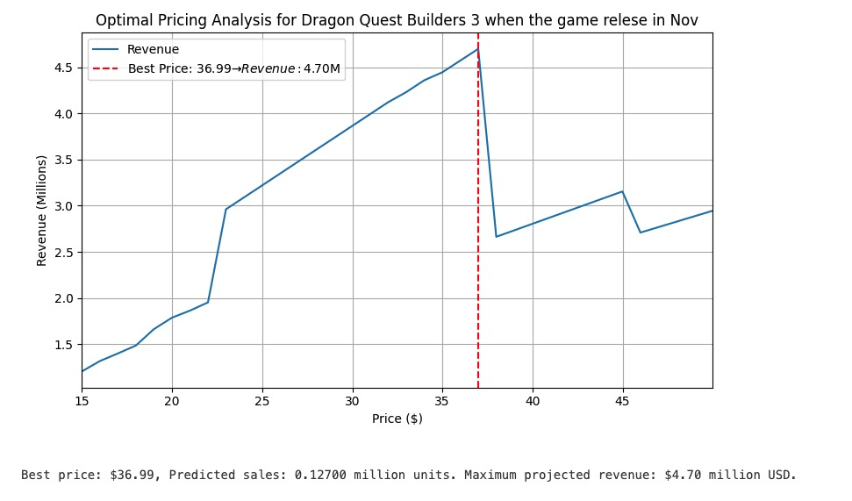
Case Study Conclusion

